Slide 1

We Are For You
A NGO Organisation
Batch 6 :
Team members
1.K Kartthik
2.B Subba Rayudu
3.Yakub Nayak
4.D Krishna Karthik

Slide 2
01
04
02
03
Problem Statement
Objectives
Uml Use Case Diagram
Uml Class Diagram
05
06
E-R Diagram
Reactjs and microservices
Table of Contents
07
08
Junit testing using mockito
Code coverage using Eclemma
09
10
Updates in future
Sneakpeak of project

Slide 3
Problem Statement
In today’s world , millions of people struggle with issues such as poverty , social inequality , lack of education. Ngo’s play a vital role in addressing these issues.
Despite the efforts of Ngo’s , many people remain unaware of the various programs and initiatives offered by these organisations .
Ngo’s may struggle to attract funding and support from donors and partners without comprehensive and informative website that showcase their work and impact.

Slide 4
PROBLEM SOLUTION
*
Our NGO Organisation Website aims to address these challenges by providing :-
A user-friendly , informative and engaging platform for individuals to learn about its programs , achievements, and impact .
Our website will serve as a hub for the organisation initiatives , events ,and partnerships , and provide clear and concise information.

Slide 5

Objectives
To create a Ngo applications that user can donate the money to a particular projects organised by Ngo and have accountability to the user.
Volunteers can participate in the projects organised by Ngo.
Benificiaries can register for the help and they can get help from the Ngo after verification of information provided by beneficiary.

Slide 6

WHAT WE ARE WORKING ON
DONORS
VOLUNTEERS
PROJECTS

Slide 7
TECHNOLOGY STACK
Frontend | Reactjs
Backend | Spring Boot
Database | MySQL
ORM Mapping | JPA(Hibernate)
Testing | Junit, Mockito
Code Coverage | Eclemma, Jococo

Slide 8
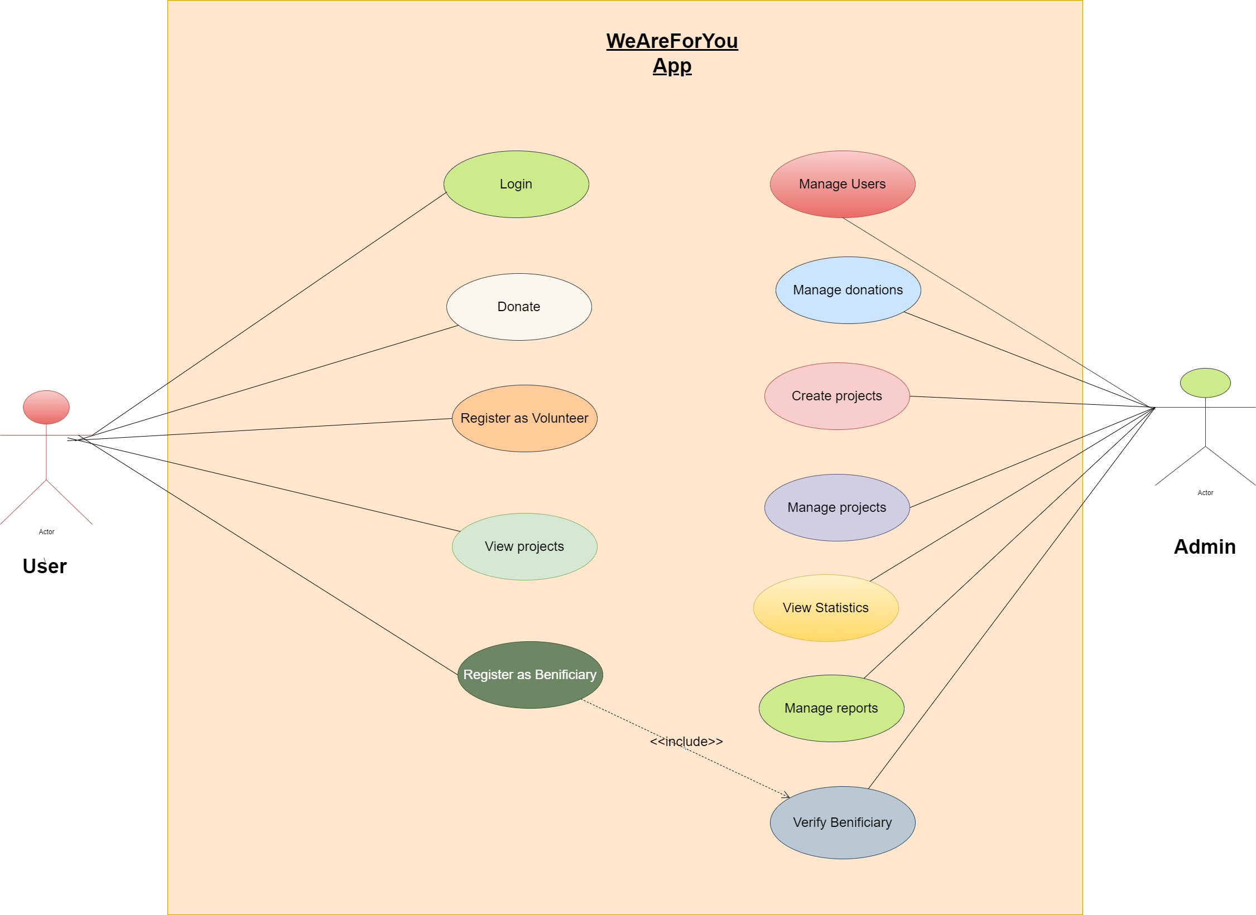
UML Use Case Diagram

Slide 9
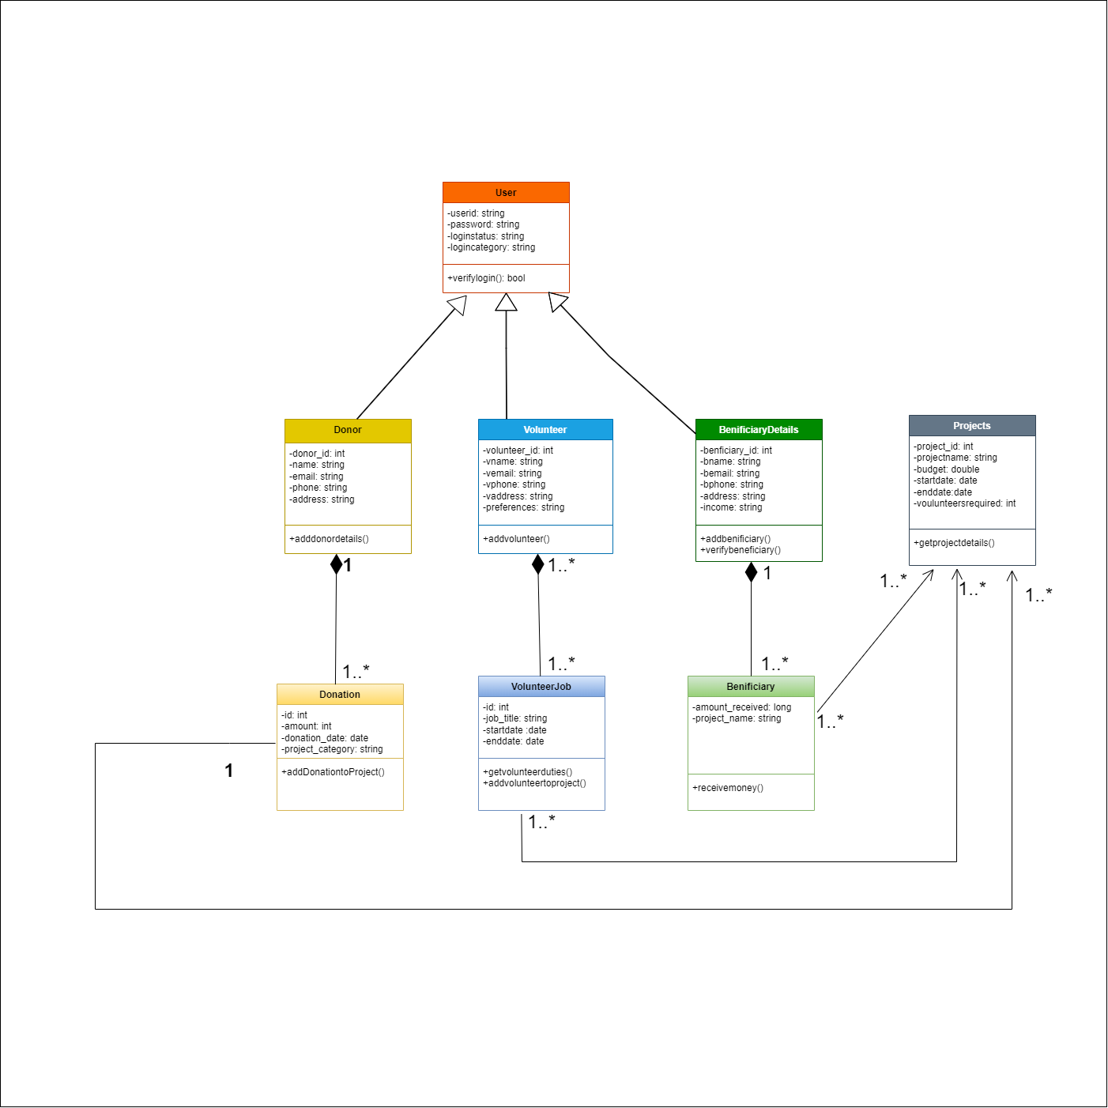
Class Diagram

Slide 10
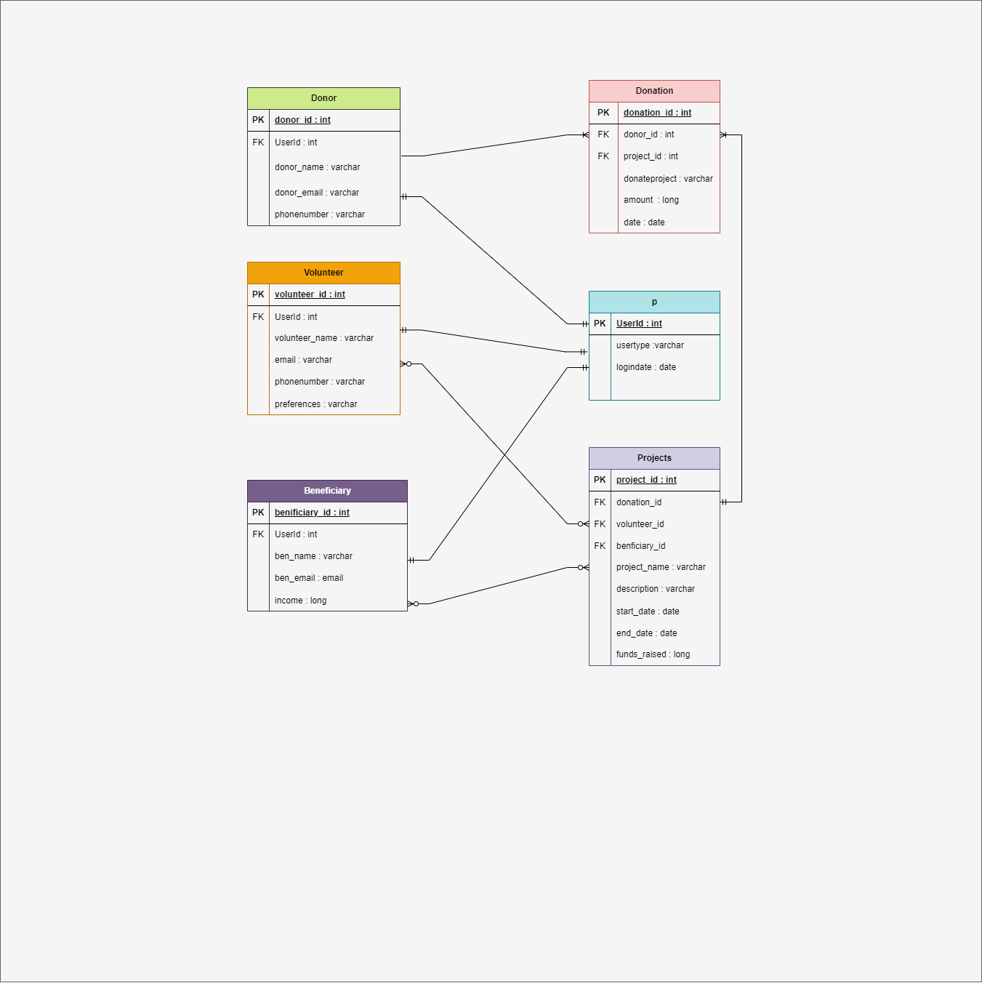
ER Diagram

Slide 11
ReactJs
we used reactjs framework as frontend for developing our weareforyou organisation
We used functional components
Router for navigating to the page without refreshing the page
We used axios to get and post the data

Slide 12
Donor microservice
It is used to save the donor details and get the donor details who donate/donated to the particular project

Slide 13
Project microservice
It is used to save the new project details and get the details of the project which are in need of funding

Slide 14
Volunteer microservice
It is the microservice in which the volunteer can register for the particular project and can get the details of the volunteer who want to participate in the particular project organised by the organisation

Slide 15
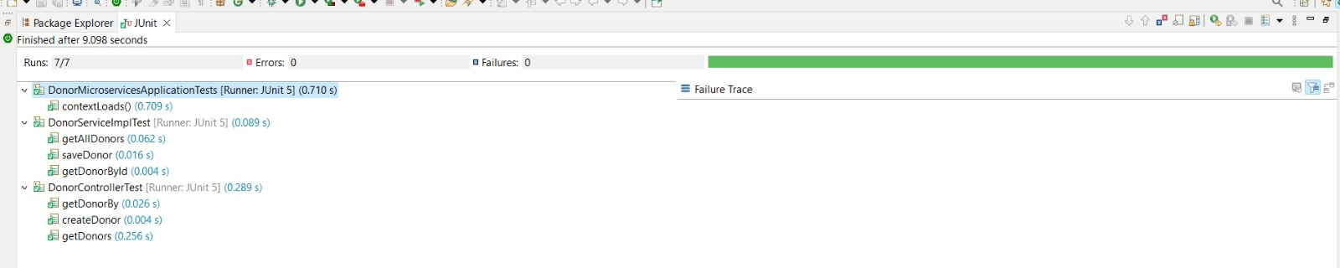
Junit testing using Mockito Donor Junit testing

Slide 16
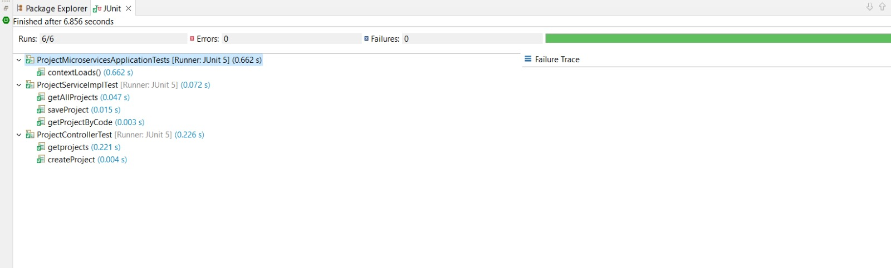
Project junit tesing

Slide 17
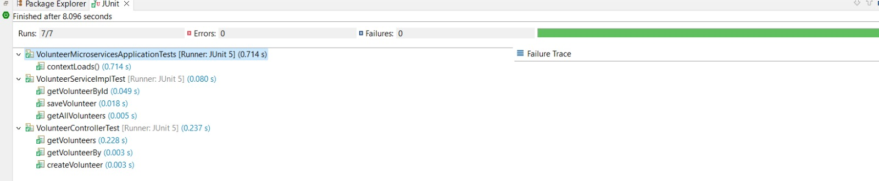
Volunteer Junit Testing

Slide 18
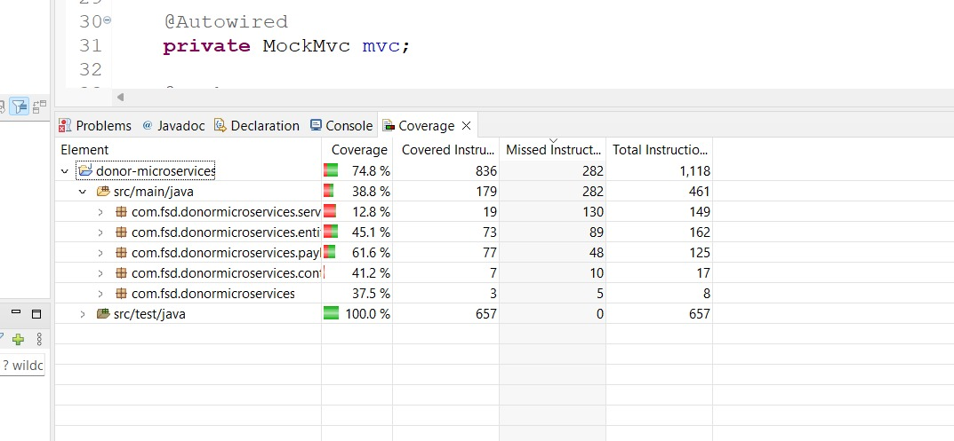
Code coverage using Eclemma Donor code coverge using Eclemma

Slide 19
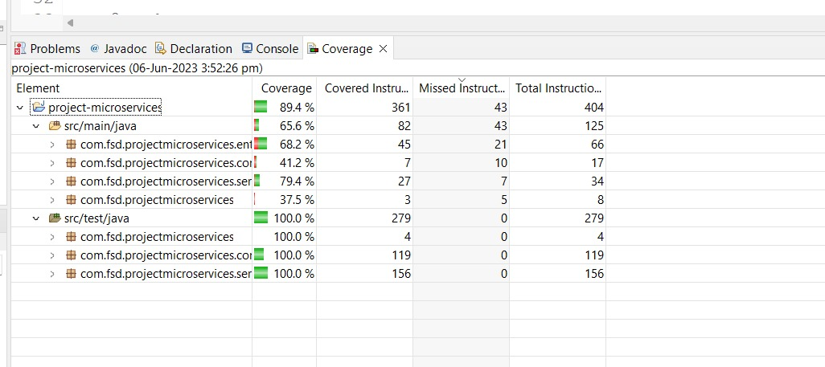
Project code coverage using Eclemma

Slide 20
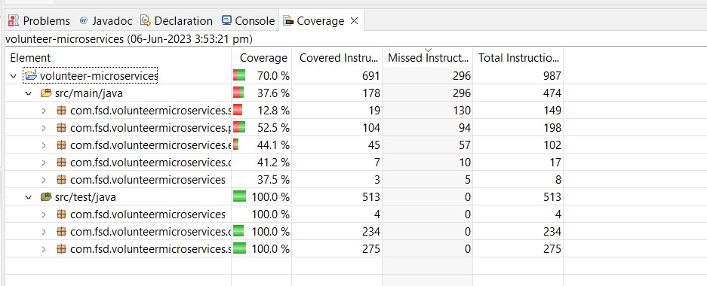
Volunteer code coverage using Eclemma

Slide 21
Updates in future..
We are trying to create beneficiary microservice
- To directly transfer the amount to the
beneficiary in which we received from the
donations to the particular project

Slide 22
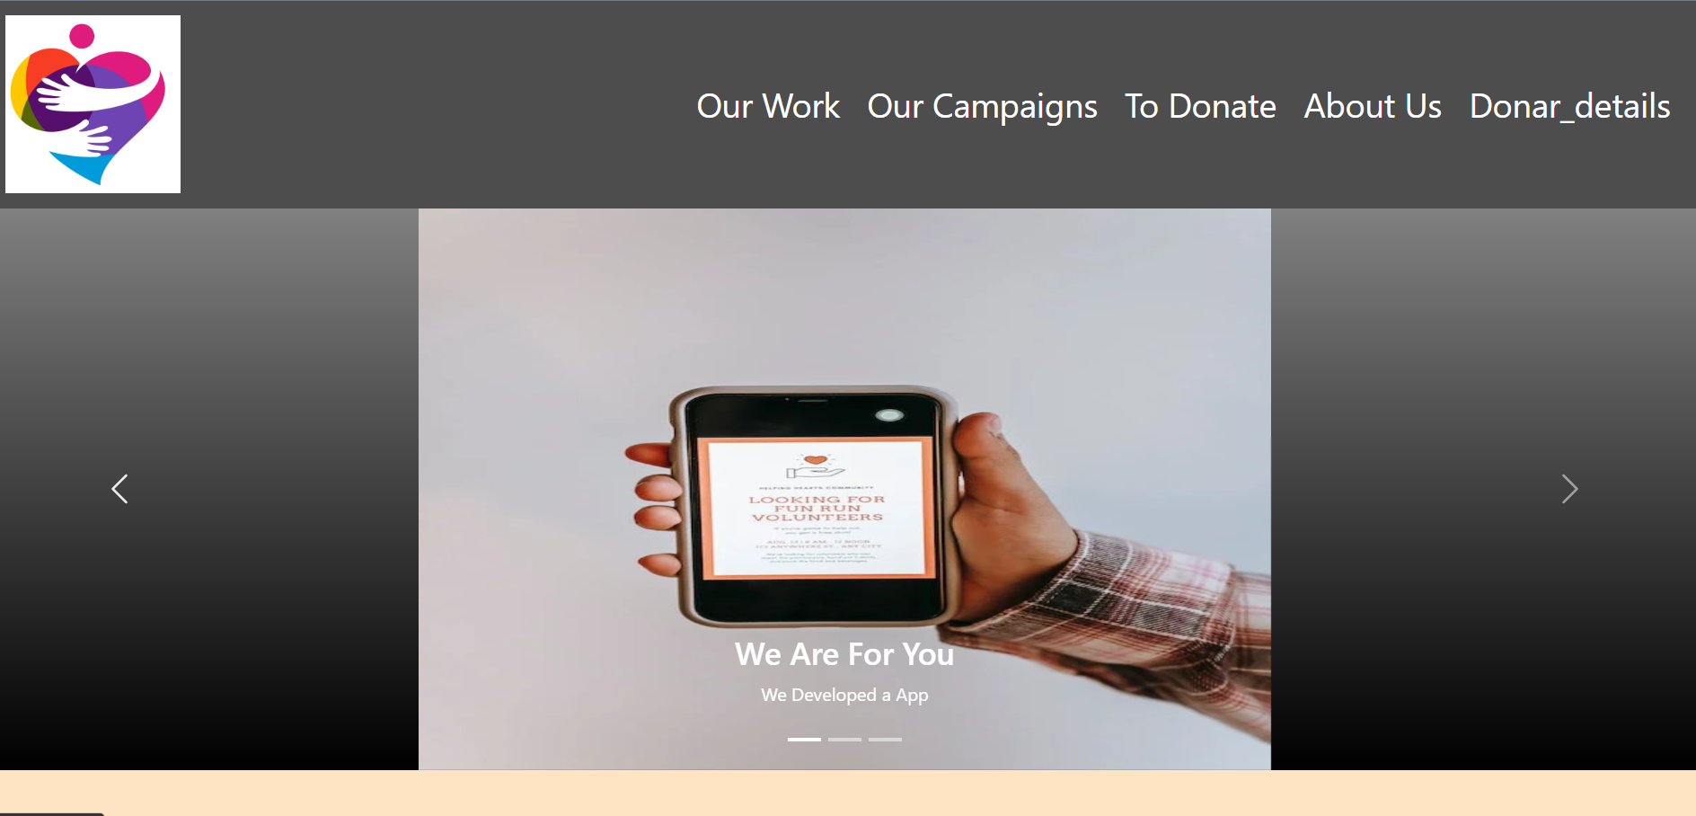
SNEAK PEEK INTO OUR WEBSITE

Slide 23
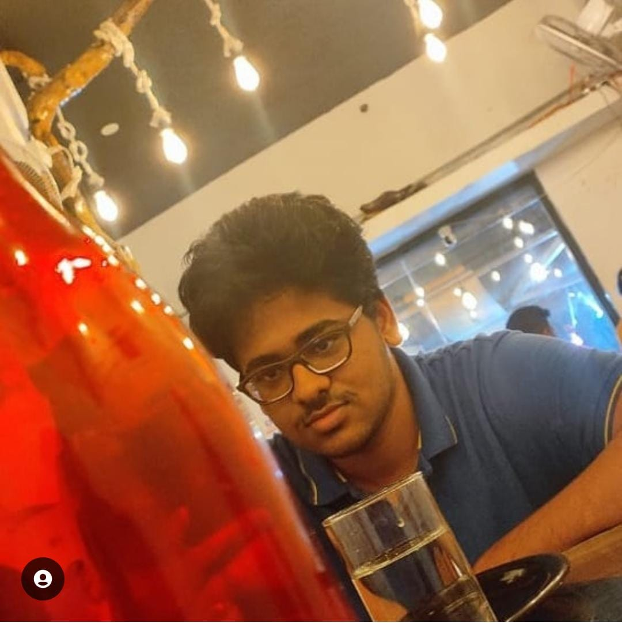
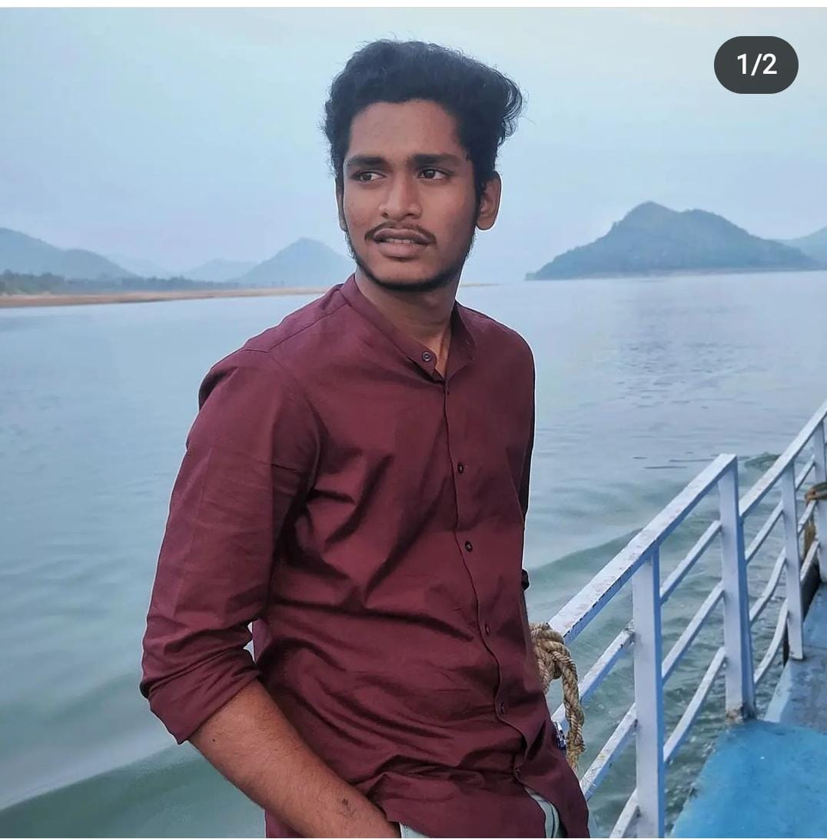
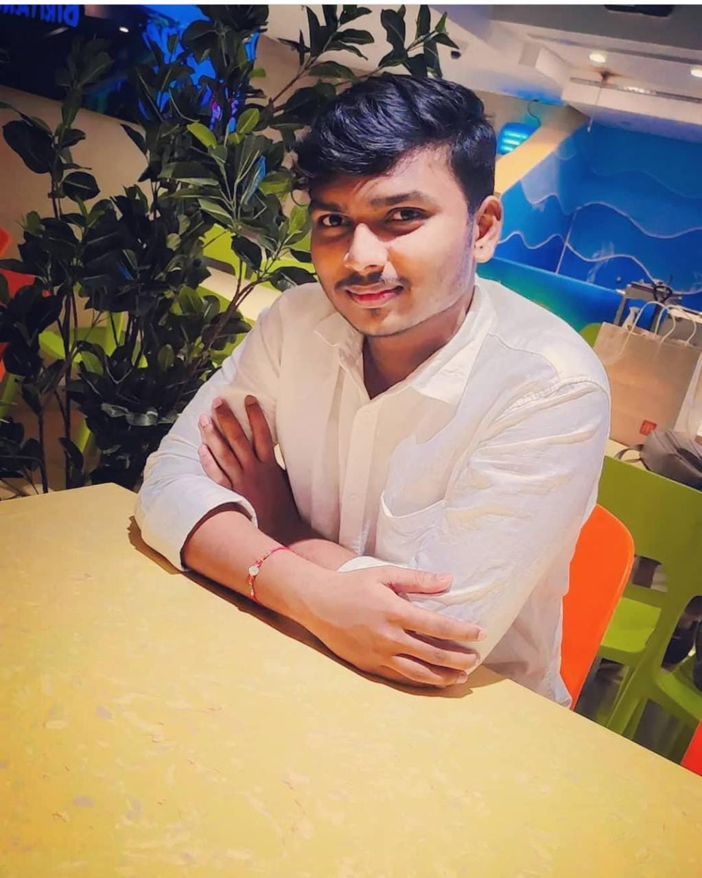
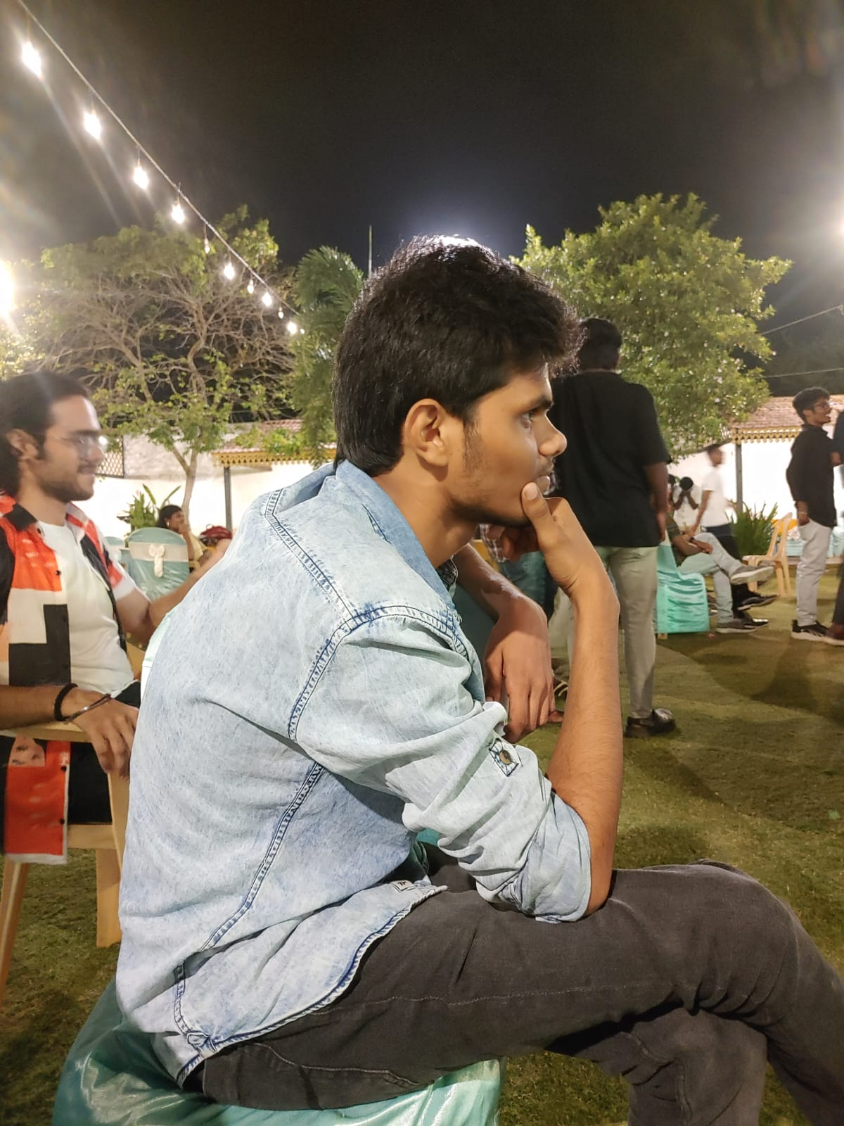
Our Team
B Subba Rayudu
K Kartthik
D Krishna Karthik
B Yakub
20CS1022
20CS1054
20CS1028
20CS1019

Slide 24
Thank you!

